Slide 1
Note to User: Delete [REMOVE PRIOR TO PRESENTATION] Slides
We invite you to use this presentation to support and communicate your Zero Suicide efforts. We have included suggested speaking points in the notes section below each slide.
This presentation is the property of Education Development Center, Inc. (EDC). By using this presentation, you agree to the following conditions:
You may add your own logo in the upper right corner of the slides
You may not alter any of the provided slides in any other way except as explicitly instructed to do so (i.e., “insert your own welcome and introductions…” and “… remove prior to presentation”). All the provided slides must retain EDC copyrights and disclaimers.
You may not use this slide template for any other purpose, other than to give or share the presentation provided here.
The contents of this presentation may not be used outside the context of its intended purpose.
Policy around permitted use of the Zero Suicide logo can be found here: https://solutions.edc.org/solutions/zero-suicide-institute/about/mission/policies

Slide 2
Legal Disclaimer
The suicide prevention content and resources provided through the services and trainings of Education Development Center, Inc. (including Zero Suicide Institute and EDC Solutions) are intended to provide organizations with a range of best practice options and resources designed to improve suicide prevention care. Please note that the recommended options and resources are not intended to be exclusive and may not be appropriate for all patient populations in all settings. Organizational leaders and staff should review other resources, protocols, and practices to select the most appropriate and complementary options that meet their ultimate goals and needs.

Slide 3
ZERO Suicide
A Commitment to Saving Lives
Organization Name
Date

Slide 4
Agenda
Presenters
Name
Name
Welcome & Introductions
What is Zero Suicide?
What Does Zero Suicide Look Like?
Elements of Zero Suicide
Closing

Slide 5
[REMOVE PRIOR TO PRESENTATION]
Choose one of the following videos to show. You may wish to access the Zero Suicide Toolkit and load the videos in a separate window, or to embed the videos into your presentation using the links below. NOTE: Be sure to test embedded videos beforehand; the Vimeo software will show an error unless the video is embedded
If you wish to load the videos in a separate window, access them via our toolkit:
Aspire to Zero: https://zerosuicide.edc.org/resources/resource-database/aspire-zero
Voices of Zero Suicide: https://zerosuicide.edc.org/resources/resource-database/voices-zero-suicide
If you wish to embed the videos, use the following Vimeo links:
Aspire to Zero: https://vimeo.com/1014439541
Voices of Zero Suicide: https://vimeo.com/1014442192

Slide 6
49,449 People Died by Suicide in 2022
This is approximately
1 Suicide Death every 10 Minutes
Notes:
The CDC provisionally reported that in 2022 almost 50,000 people died by suicide. That works out to one person dying by suicide every 10 minutes. Suicide is a public health issue, and our organization is a crucial part of the solution.
Source: CDC, 2022 https://www.cdc.gov/media/releases/2023/s0810-US-Suicide-Deaths-2022.html

Slide 7
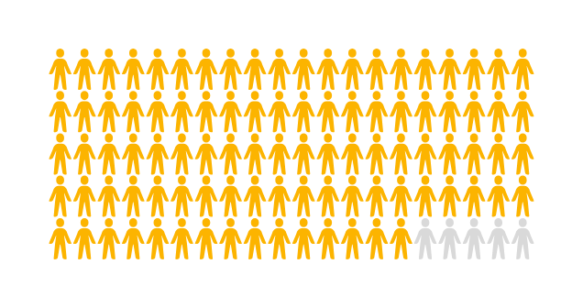
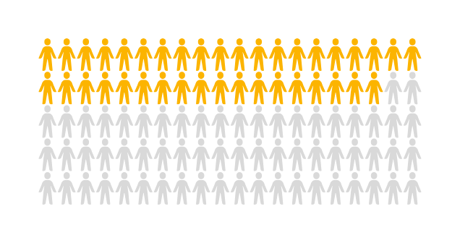
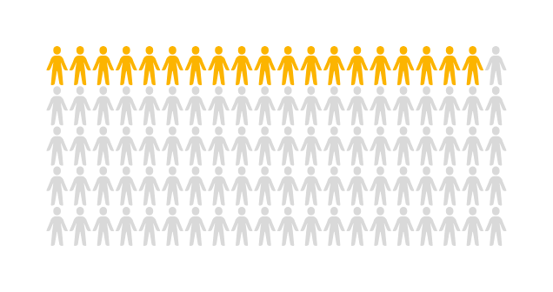
95%
Had a Healthcare Visit Within The Year Before Suicide Attempt
OF PATIENTS
(Ahmedani et al., 2015)
38%
Saw a Healthcare Provider the Week Before They
Attempted Suicide​
OF PATIENTS
(Ahmedani et al., 2015)
19%
Had Contact with a Mental Health Professional in the Month Before Their Death
OF PATIENTS
(Luoma et al., 2002)
Notes:
People who are dying by suicide are seen by healthcare professionals before their death. One study showed that 95% of people who attempted suicide had a healthcare visit in the year before their suicide attempt. 38% had a visit the week before they attempted suicide. In addition, 19% of individuals who died by suicide saw a mental health professional in the month before their death. We also know that many people are seen in emergency departments shortly before their deaths. Health care professionals often fail to ask about suicide risk either because they were never trained to, don’t know how to recognize suicide warning signs or risk factors, don’t know what to do if someone is at risk for suicide, or wrongly believe that they don’t need to ask -- that the person at risk would tell them if they were feeling this way.
Ahmedani, B. K., Stewart, C., Simon, G. E., Lynch, F., Lu, C. Y., Waitzfelder, B. E., Solberg, L. I., Owen-Smith, A. A., Beck, A., Copeland, L. A., Hunkeler, E. M., Rossom, R. C., & Williams, L. K. (2015). Racial/ethnic differences in healthcare visits made prior to suicide attempt across the United States. Medical Care, 53(5), 430–435. https://doi.org/10.1097/MLR.0000000000000335
Luoma, J. B., Martin, C. E., & Pearson, J. L. (2002). Contact With Mental Health and Primary Care Providers Before Suicide: A Review of the Evidence. The American Journal of Psychiatry, 159(6), 909–916. https://doi.org/10.1176/appi.ajp.159.6.909

Slide 8
What Does Zero Suicide Look Like?
ENGAGING IN THE WORK
PRIORITIZING
ZERO SUICIDE
REDUCING
BARRIERS
Leaders are crucial to success.
Notes:
Zero Suicide aims to change all of that and implement multiple processes, interventions, and treatments to help catch people in healthcare and keep them safe while they are in care.
So, what does Zero Suicide look like? It looks like leadership is involved over time. We know that organizational change is more successful when its leaders are onboard with the work. And we know organizational culture change takes time. Leaders who are committed and involved are crucial for this to happen. We need them to be engaged in the work, to prioritize it and to work to reduce any barriers.

Slide 9
Zero Suicide is a Team Effort
Everyone has a role to play in suicide prevention​
Everyone will get some training specific to your role
Notes:
Everyone is on the Zero Suicide team and has a part in making Zero Suicide successful in our organization. Everyone is an important part in suicide prevention no matter what their role is. Training is part of any new initiative and so everyone will get some training on suicide. People who work with patients directly will get certain trainings and people who work in non-clinical roles will also have some training related to suicide.

Slide 10
Aim for ZERO and Prepare to Support Staff When a Patient Dies by Suicide
1
2
3
POSTVENTION SUPPORT
JUST
CULTURE
EMPLOYEE
WELLNESS
Notes:
A Zero Suicide organization aims for no patient suicide deaths and also prepares for when a patient dies by suicide. Aiming for zero helps us have a certain mindset. If we’re aiming for a certain reduction of suicide deaths that could be interpreted that there is another acceptable number of suicide deaths. Zero is really the only acceptable number. And because we also know that there are many things that contribute to a person’s decision to take their own life we will make sure we have good postvention support for staff after a patient dies by suicide. A big part of Zero Suicide is having a Just Culture which means that when there is an incident or an error we focus on identifying system gaps instead of blaming staff. Also, Zero Suicide includes supporting the wellness of our employees who are doing the hard work of helping people who are at risk of suicide.

Slide 11
PROCEDURES
Values of people who have lived experience with suicide care
LIVED EXPERIENCE
WORK
FLOWS
POLICIES
Notes:
A cornerstone of Zero Suicide is the inclusion of people who have lived experience of suicide attempts or have lost someone to suicide. We want to include the perspective and input of people with lived experience when we develop policies, procedures, and workflows. Their perspective and recommendations will help us develop truly person-centered approaches for patients at risk of suicide.

Slide 12
Zero Suicide is a Journey That Never Ends
CORE COMPONENTS OF SAFE SUICIDE CARE
Continuous Quality Improvement
Collecting, reviewing, and using data to improve​
Assuring fidelity to the Zero Suicide framework
Notes:
Zero Suicide isn’t just a training or a screening process. It’s intended to be a journey without a destination. We want to have the mindset and the processes to support the collection, review and use of data to improve the way we care for patients and support employees. We also want to make sure we have fidelity to the Zero Suicide framework and to the interventions and procedures we implement. Zero Suicide is a continuous quality improvement project. It’s not something to implement and move on.

Slide 13
What Does Zero Suicide Look Like?
Seeking new and better ways to help our patients
Using culturally appropriate, evidence-based tools and practices
Training to improve comfort, confidence, and competence to work with suicidal patients ​
Notes:
Zero Suicide is a framework that is intended to be adaptable to our organization and the populations we serve. It centers cultural appropriate and evidence-based tools and practices. And includes training that doesn’t just focus on knowledge and skills but increases the comfort and confidence as well as the competence of our staff to work with our most at risk patients.

Slide 14
[REMOVE PRIOR TO PRESENTATION]
Show the following video. You may wish to access the toolkit and load the videos in a separate window, or to embed the videos into your presentation using the links below.
NOTE: Be sure to test embedded videos beforehand; the Vimeo software will show an error unless the video is embedded.
If you wish to load the video in a separate window, access it via our Toolkit:
7 Elements of Zero Suicide: https://zerosuicide.edc.org/resources/resource-database/seven-elements-zero-suicide
If you wish to embed the videos, use the following Vimeo link:
7 Elements of Zero Suicide: https://vimeo.com/881844818
Notes:
Zero Suicide is a framework that is organized into seven different elements. Here is a video that briefly goes over these elements.
https://zerosuicide.edc.org/resources/resource-database/seven-elements-zero-suicide
https://vimeo.com/881844818

Slide 15
Zero Suicide Toolkit
The online Zero Suicide Toolkit offers free and publicly available tools, strategies, and resources.
CORE COMPONENTS OF SAFE SUICIDE CARE
RESOURCES
Information
Materials
Outcomes
Innovations
Research
Tools
Readings
Videos
Webinars
Podcasts
CORE COMPONENTS OF SAFE SUICIDE CARE
ZeroSuicide.edc.org
Notes:
The Zero Suicide website is something that all of us can use for different resources that might be helpful as we start implementing different parts of Zero Suicide. The Toolkit has a lot of great information and resources. The website address is: www.ZeroSuicide.edc.org.

Slide 16
Thank You
Visit zerosuicide.edc.org to learn more about Zero Suicide
Contact zerosuicide@edc.org for questions or assistance
Notes:
We are really excited to start this work and looking forward to everyone’s contributions. Providing the best care for our patients is who we are, not only what we do. The work we do in Zero Suicide will provide us a holistic and comprehensive path to follow that will improve our organizational culture as it related to suicide care for our patients.

