Slide 1


Supportive Care Pathway Training
Train the Champion

Slide 2
Why Change the Current Pathway?
Name change: Suicide Care Pathway to Supportive Care Pathway (trauma-informed influences)
Feedback on barriers/pain points from providers
Feedback from clients who do not want to receive check-ins or even be on the pathway
Empower providers to use clinical judgement
Empower clients to take an active role in their care
Notes:
Over the last year since implementing the Suicide Care Pathway, we have received feedback with similar pain points system-wide.
We understand the frustration the current pathway has caused, and want to ensure we are doing what we can to improve this for both our providers and the clients we serve
With these changes we hope to empower our providers to use clinical judgement, as well as empower our clients to use their voice and have an active role in their care

Slide 3
Objectives
Provide history and background of Zero Suicide & Care Pathways
Review the Pathway & Pathway Processes
Clarify Roles & Expectations
Review Avatar Functionality

Slide 4
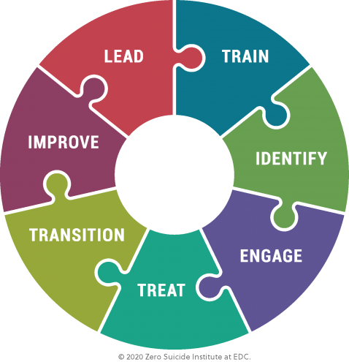
Zero Suicide & Care Pathway Overview
What is Zero Suicide?
  Developed in 2012 by Suicide Prevention advocacy groups at the National Level and is now implemented in over a thousand systems in the US and around the world
  Rooted in 7 Essential Elements
Notes:
Zero Suicide is a commitment to suicide prevention in health and behavioral healthcare with a specific set of tools and strategies. It is both a concept and a practice. Its premise is that suicide deaths for people under care are preventable and that the bold goal of zero suicides among persons receiving care is an aspirational challenge that health and behavioral healthcare systems should accept. The Zero Suicide approach aims to improve care and outcomes for individuals at risk of suicide in health and behavioral healthcare systems.
Zero Suicide is rooted in the seven essential elements of suicide care:
Lead system-wide culture change committed to reducing suicide
Train a competent, confident, and caring workforce
Identify individuals with suicide risk via comprehensive screening and assessment
Engage all individuals at-risk of suicide using a suicide care management plan
Treat suicidal thoughts and behaviors using evidence-based treatments
Transition individuals through care with warm hand-offs and supportive contacts
Improve policies and procedures through continuous quality improvement

Slide 5
Care Pathway Model
  A care pathway is a standardized set of processes or guidelines applied to a group of clients with a similar condition
  Inspired in 1985 New England Medical Center in Boston (medical and nursing protocols)
  Utilized by healthcare systems to manage quality of care

Slide 6
Care Pathway Model continued
What is a Supportive Care Pathway?
  Tool to guide treatment for clients at risk for suicidal behaviors
  Outlines parameters for a client’s experience on the pathway
Notes:
The Supportive Care Pathway is the tool used to guide treatment for the clients who have been identified as moderate or high risk for suicidal behaviors after they have been administered the Columbia Suicide Severity Scale.
The pathway outlines the frequency of contacts the client will receive while they are on the pathway as well as the parameters that will be met before being removed from the pathway.
The Supportive Care Pathway provides the treatment team the opportunity and guidance in offering additional care and support to the client.

Slide 7
Care Pathway Model cont’d
Why implement a Supportive Care Pathway?
  Improve care for the most at-risk clients
  Provide staff with clear direction and sufficient resources to provide the best care possible
  Suicide prevention is part of our culture

Slide 8
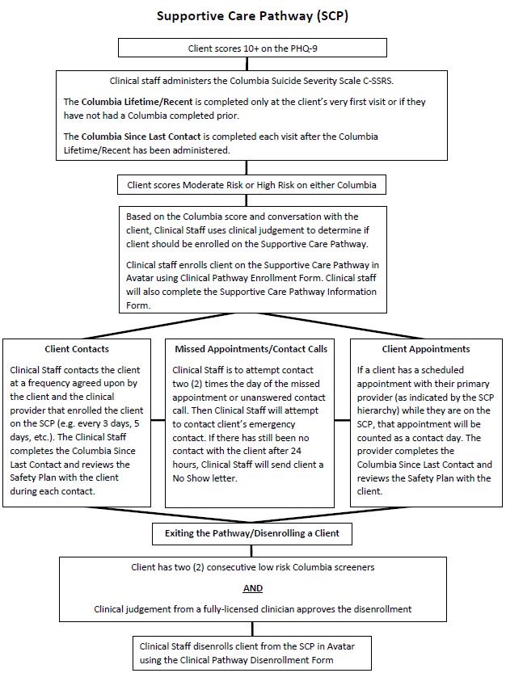


Slide 9
Pathway Process: Enrollment
  Step 1 - How does a client get on the pathway?
    Any provider administering the PHQ9 where the client scores 10+ → Columbia - Moderate or High Risk, can place the client on the Pathway
OR
    A Licensed Clinician may use clinical judgment to put someone on the Pathway, regardless of screener outcomes, and at any point in course of treatment
  Step 2 – Supportive Care Pathway Client Handout (Adult & Youth Versions)
    Provider adding client to pathway is required to review this with the client and guardian (if applicable) at time of moderate/high risk Columbia
    Contact information for a trusted friend or family member is gathered and entered into Avatar at time of appointment – permission form must be updated for individuals not included on current permission form.
  Step 3 - Treatment Planning
    The primary provider adds a goal or objective relating to the Pathway to the client’s treatment plan
    Goals and Objective Samples for Supportive Care Pathway in Treatment Plans:
    NOTE: These are just samples of how to format your goals and objectives. These are not to be copy and pasted
      Goal: Reduction of suicidal risk factors and monitoring suicidal risk factors as client is on the suicide care pathway.
      Objective: Client will be screened using the Columbia Suicide Screener at every session until the client’s
      risk factors/scores have reduced.
      Objective: Client will be asked about suicidal ideation at every visit until the next treatment plan review.
      Objective: Provider will have contact with client (predetermined timeframe: once a week/once a month) to
      assess suicidal ideation and client’s emotional state for the next 90 days.
Notes:
Examples Goals and Objects for Supportive Care Pathway in Treatment Plans.
Providers need to write goals/objects in their own words for each client, not just copy and paste examples.

Slide 10
Pathway Process: Enrollment cont’d
  Step 4 – Supportive Care Pathway Information Form
    Provider adding client to pathway is responsible for filling out this form and including all current providers
    Primary provider depends on which service(s) client receives, see hierarchy on next slide
    New providers are responsible for updating the Supportive Care Pathway Information form as they are added to the treatment team
    If a client is discharging from a service, the provider of that service will update this form and communicate with the treatment team
    There is a field on this form that asks if you provided the SCP handout to the client
    There is a field on this form that allows you to select if the client needs to be enrolled in a pathway – selecting “Yes” will prompt you to complete the Clinical Pathway Enrollment form

Slide 11
Provider Hierarchy
Service(s) | Primary Provider/ Who is Responsible to Make the Contact/Call
CPR, Recovery, Outpatient, Psychiatry | CSS or SBSS
Recovery, Outpatient, Psychiatry | Recovery Provider
Outpatient (SBS), Psychiatry | SBS Provider
Outpatient (non-SBS), Psychiatry | Crisis Team
Psychiatry | Crisis Team
Outpatient (SBS) | SBS Provider
Outpatient (non-SBS) | Crisis Team
Developmental Services | Developmental Services Provider
Autism | Autism Provider

Slide 12
Pathway Process: Enrollment cont’d
Step 5 - Clinical Pathway Enrollment Form
  Provider adding client to pathway as a result of clinical action or decision will complete this form in Avatar
  Supportive Care Pathway should be selected as “Primary” pathway on this form
  Supportive Care Pathway visual enhancements in myAvatar
Step 6 – *For outpatient therapy and psychiatry only clients*
  Outpatient Therapy
    Provider and client agree upon a contact check-in frequency (i.e. every 3 days, 5 days, etc.)
    Provider and client identify a preferred time for check-ins with client
    Provider completes SCP Crisis Follow-Up Form and emails to Crisis SW Team email group
  Psychiatry
    Nursing team and client will identify a preferred time for check-ins with client
    Nursing team will submit SCP Crisis Follow-Up Form to Crisis SW Team email group

Slide 13
Roles & Responsibilities
  Primary Provider (according to hierarchy)
    Discussing with client the importance of the Pathway, providing handouts and discussing with the client their preferred contact frequency.
    Responsible for making follow-up contacts within Burrell work week, excluding Burrell Holiday weekends only.
    Therapy/Psychiatry only clients – Crisis Team makes follow-up contacts, except if provider is scheduled to see client. These providers are responsible for providing handouts, discussing when client would like to be contacted by the Crisis Team (frequency and time of day) and filling out the SCP Crisis Follow-up request and emailing it to the Crisis Team SW email group.

Slide 14
Roles & Responsibilities cont’d
  Nursing
    If client is in CPRC:
      Nurse will complete enrollment steps
        CSS will be the primary provider.
      Provide client with copy of safety plan
      Nurse will notify medical clerks of the clients addition to the SCP.
        Medical clerks will notify CSS & CSSS of addition to the SCP via email.
    If client is Psychiatry only:
      Crisis Team will make the client contacts
      If the client has therapy services, the therapist will be the primary provider
      If the client only has psychiatry services, the psychiatry provider is the primary provider
      Follow the above steps, but nurse will include the SCP Crisis Follow-up request in their email to medical clerks, being careful to provide a follow-up frequency and time agreed upon with the client on the form
        Medical clerks will notify Crisis Team of the addition to the SCP by emailing the Crisis Follow-up request form

Slide 15
Roles & Responsibilities cont’d
  Outpatient Therapy
    If client is Outpatient Therapy only:
      Complete enrollment steps
      Provide client with copy of safety plan
      Crisis Team will make the client contacts, except on days where the client is scheduled to see the provider.
        Notify the Crisis Team of the addition to the SCP by emailing the SCP Crisis Follow-up request for with the agreed upon client contact frequency and time.

Slide 16
Roles & Responsibilities cont’d
Clinical Intake Specialists
  Complete enrollment steps
    CIS will be primary provider until client is connect to service provider
  Provide client with copy of safety plan
  Crisis Team is responsible for follow-up contacts until client is connected to service provider
    Notify the Crisis Team of the addition to the SCP by emailing the SCP Crisis Follow-up request for with the agreed upon client contact frequency and time.
  If no services are recommended or agreed to at time of IAED, the client would not be enrolled on the SCP. An authorization to disclose to outside providers should be obtained in order to share concerns/coordinate care.

Slide 17
Roles & Responsibilities cont’d
  Crisis Team
    The Crisis Team completes regular follow-up contacts for clients receiving Outpatient and Psychiatry services only.
    The Crisis Team completes Burrell Holiday weekend contacts for clients in CPR, Recovery Services, Autism or Developmental Services who are on the Pathway.
      See Burrell Holiday schedule located on BurrellNet
    The primary provider or provider enrolling someone on the pathway is responsible for completing and emailing the SCP Crisis Follow-Up form to the Crisis Team SW email group (CrisisTeamSW@burrellcenter.com). Requests should be submitted before noon on the day before the Burrell Holiday weekend.
    The Crisis Team will document in an independent note in the client’s chart.
    For CPR, Recovery, Autism and Developmental service lines, the primary provider is responsible for engagement attempts, if needed, on the next business day.

Slide 18
Pathway Enrollment Checklist
Step | Details
Review and Provide SCP Client Handout (Youth or Adult) | Print physical copy for client from BurrellNet (Supportive Care Pathway folder) If client is being seen via telehealth, send client a copy via encrypted email.
Enroll Client in Pathway | Completed in myAvatar using Clinical Pathway Enrollment form
Complete Supportive Care Pathway Information | Completed in myAvatar using Supportive Care Pathway Information form: Client’s Contact Information Contact Frequency Handout Provided (Y/N) Primary Contact Person (Provider) Non-Primary Care Team Members
Complete Client’s Treatment Plan | Completed and signed by client in myAvatar; print physical copy for client If client is being seen via telehealth for an initial intake appointment, send to client via DocuSign or work with ROI to send to client via mail or encrypted email
Complete Client’s Safety Plan | Completed and signed by client in myAvatar; print physical copy for client If client is being seen via telehealth for an initial intake appointment, send to client via DocuSign or work with ROI to send to client via mail or encrypted email
Complete SCP Crisis Follow-up form, if necessary (Outpatient only clients, Psychiatry only clients or if contact will fall on Burrell Holiday weekend) | Complete fillable PDF on BurrellNet (Supportive Care Pathway folder) and email to Crisis, CrisisTeamSW@burrellcenter.com Be sure to include time of day client requested to be contacted by Crisis

Slide 19
Pathway Process: Contact Requirements
  Columbia – Moderate or High Risk
    Columbia Suicide Screener Lifetime/Recent – completed only at the client’s very first visit OR if they have not had a Columbia completed prior.
    Columbia Suicide Screener Since Last Contact – completed each visit after the Columbia Lifetime/Recent has been administered.
  Follow-up Visits/Contacts
    Primary provider (according to hierarchy) is responsible for follow-up during regular business hours
      Coverage plan if a provider is absent (unplanned) *varies by department
        BBH Caseload with Date of Last Service Report
    Primary Provider (or Crisis Staff) contacts client at a frequency agreed upon by the client and the clinical provider that enrolled the client on the SCP (i.e. every 3 days, 5 days, etc.)
      Collaboration is key! Clinical providers can recommend a contact frequency, but it is important to have collaborative conversation with the client as it is ultimately the client’s choice.
    Primary Provider (or Crisis Staff) completes the Columbia Since Last Contact during each visit/contact
    Primary Provider (or Crisis Staff) reviews the Safety Plan during each visit/contact
      If no changes, document in progress note
      If changes needed, update Safety Plan and obtain signature
Notes:
Discuss client’s choice in frequency of contacts being one of the biggest differences with the new pathway
Providers are responsible for collaborating with the client on contact frequency, based on client’s needs and clinical judgment. Clinical provider can recommend a contact frequency to the client but it is ultimately up to the client.
Clinical provider needs to make sure they are documenting the reason for the choice of contact frequency based on conversation with the client and their treatment plan.
Requiring a client to be contacted at a frequency they do not agree to or will not respond to defeats the purpose of the Supportive Care Pathway. It truly is about making sure the client is heard and feels supported.

Slide 20
Pathway Process: Contact Requirements cont’d
  Clients not wanting to be contacted or not wanting to be enrolled in the Pathway
    Enrolling staff is responsible for communicating importance of SCP and suicide prevention as part of client’s care.
      We are here to support the client’s needs. Have an honest conversation with the client about what those needs are and how the SCP can help support them.
    If the client does not want to be contacted, enrolling staff enters “0” days into the integer field on Contact Frequency section of Supportive Care Pathway Information Form
      Provider should also thoroughly document that client met SCP criteria but client does not wish to be contacted
    If the client does not want to be enrolled on the Pathway or continue in Burrell services, provider should not enroll client in the SCP
      Provider should also thoroughly document that client met SCP criteria but client does not wish to be enrolled in SCP
Notes:
Part of caring for our client’s is respecting their autonomy and not requiring them to receive contacts/phone calls they do not want. This can be detrimental to their treatment goals/progress.

Slide 21
Pathway Process: Contact Requirements cont’d
Clients who do not have a phone and are unable to be contacted for follow-ups
  Enrolling staff should select the check box on the Supportive Care Pathway Information form indicating that client does not have a phone.
  Enrolling staff (if Southwest or Central Region) should discuss with client the opportunity for client to contact the Crisis Team rather than attempt to receive follow-up calls.
    Enrolling staff should complete SCP Crisis Follow-up Form, indicating that the client does not have a phone and detailing the time and frequency that client agreed upon to contact the Crisis Team.
  Enrolling staff should document that client does not have a phone but discussed with client the option to call the crisis line for support as needed if symptoms continue or increase.

Slide 22
Pathway Process: Documentation
  Documentation
    Client Progress Note – Existing Appointment/New Service
      Intervention should include language regarding Supportive Care Pathway follow-up, Columbia administration and Safety Plan update/review
    Client Progress Note - Independent Note
      Select “Supportive Care Pathway Contact” Note as Note Type when documenting follow-up contact in client’s chart
      Note should include language regarding Supportive Care Pathway follow-up, Columbia administration and safety plan update/review.

Slide 23
Pathway Process: Client Cancellations & NOS
  Appointment Cancellation
    Contact with a member of the treatment team or Crisis Team is required
    Client Access will attempt to reach provider or another member of treatment team via Zoom and wait 45 seconds for a response
      If no response, Client Access completes a warm hand-off of client to Crisis Team
    Provider or, when appropriate, Crisis Team checks in on client’s well-being, reviews Safety Plan and reschedules appointment
  Appointment No-Show – Steps to Reach Client
    Provider attempts to call client on same date of scheduled service up to two times. If no answer then;
    Provider attempts to reach by phone the identified family member or friend;
    If a CPR client and client does not respond to additional call attempts, CSS attempts a home check-in within a week of the missed appointment;
    Provider may initiate a wellness check with local law enforcement or a Burrell team member.

Slide 24
Exiting the Pathway
  Exit Criteria
    Client has two (2) consecutive low risk Columbia scores
    AND
    Clinical judgement from a fully-licensed clinician approves the disenrollment
  Removing client from the Pathway in myAvatar
Step | Details
Disenroll Client from the Pathway | Completed in myAvatar using Clinical Pathway Disenrollment form *Be sure to select Supportive Care Pathway as the Pathway Name
IF discharging a client from all Burrell services, disenroll the client from the Pathway | Completed in myAvatar using Clinical Pathway Disenrollment form *Be sure to select Supportive Care Pathway as the Pathway Name
Notes:
NOTE: If a client is being discharged from all Burrell services, they need to be disenrolled from the Pathway. Keeping them enrolled on the Pathway results in them showing up on reports which can skew data and may result in unnecessary contacts to those clients that are no longer in Burrell services.

Slide 25
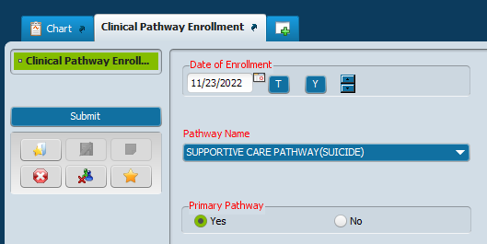


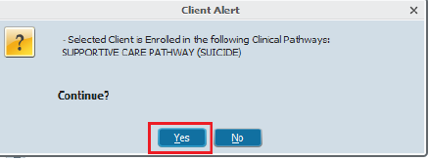
myAvatar Functions for the Pathway - Enrollment
Form Name: Clinical Pathway Enrollment
*Always set the Supportive Care Pathway as the primary pathway
 | Visual changes that occur in myAvatar:
Notes:
The enrollment and disenrollment forms and process do not change. This will be exactly the same as before.
Mention that there is a desk guide that goes in-depth on how to use these tools. This is included with the other resource information outlined in the last slide.

Slide 26
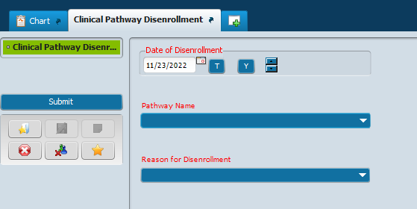
myAvatar Functions for the Pathway - Disenrollment
Form Name: Clinical Pathway Disenrollment
 | Disenrollment Reasons: Client Death - By Suicide Client Death - Natural or Other Causes Client Dropped Out of All Treatment Client Exited Against Medical Advice Enrolled in recovery program - SBIRT only* Met Criteria for exiting SBIRT pathway* Met Criteria for exiting SCP pathway * These reasons should not be selected for disenrollment of Supportive Care Pathway clients
Notes:
The enrollment and disenrollment forms and process do not change. This will be exactly the same as before.

Slide 27
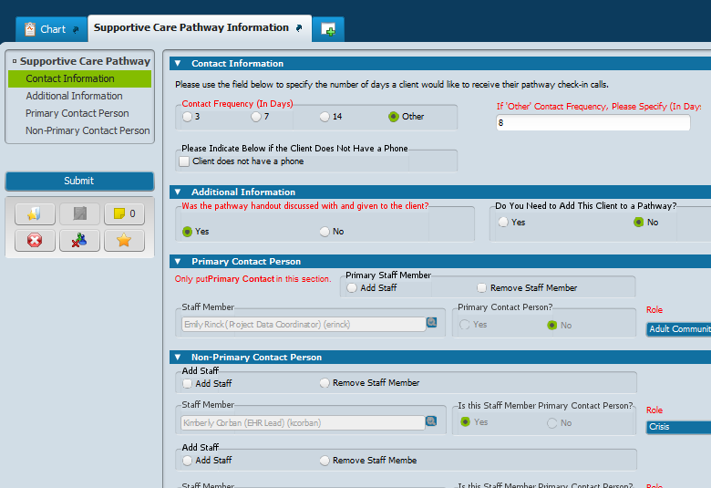
myAvatar Functions for the Pathway - Supportive Care Pathway Information Form
Form Name: Supportive Care Pathway Information
 | You will be able to add the following from this form: Contact Frequency Primary Provider Non-Primary Providers (Care Team) Handout Status
Notes:
This form was previously known as the ‘Client Care Team’ form, but has been repurposed as a SCP hub for staff. The same fields exist on the new version of this form; the only differences are the name of the form has changed and we have added a few new fields to the top of the form.

Slide 28
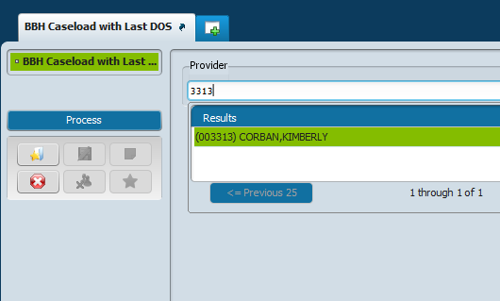
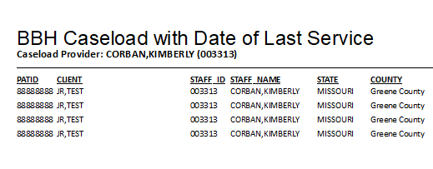
myAvatar Functions for the Pathway - Caseload Report
Form Name: BBH Caseload with Last DOS
Notes:
This is used primarily for supervisors who need to make sure any pathway clients on their team receive appropriate contacts.

Slide 29
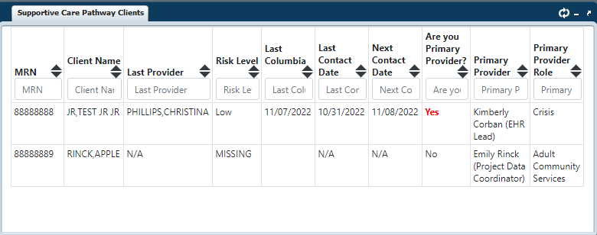
myAvatar Functions for the Pathway - Supportive Care Pathway Clients Widget
The widget shows important information about pathway clients.
Clients will only show on this widget if:
You are listed as a member of their care team on the form ‘Supportive Care Pathway Information’
They are actively enrolled in the Supportive Care Pathway
Notes:
The myAvatar desk guide shares details on each column in this widget.

Slide 30
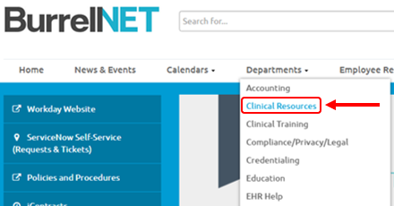
SCP Resources
  All resources are available under the Clinical Resources Library located on the BurrellNet - SCP Clinical Resources Library or BurrellNet → Departments → Clinical Resources → Clinical Resources Library → Supportive Care Pathway
    Training PowerPoint
    Link to Training Video
    Supportive Care Pathway Flowchart
    Supportive Care Pathway FAQ Document
    Supportive Care Pathway Client Handouts
    Supportive Care Pathway myAvatar Guide
    Supportive Care Pathway Crisis Follow-Up Form
  Department Champions
    Each Department has identified Supportive Care
    Pathway Champions. Please reach out to your
    department leadership to identify current champions.
  Supportive Care Pathway Consult Group (email group)
    SupportiveCarePathwayConsult@burrellcenter.com

Slide 31
Questions?

