Slide 1
Note to User: Delete [REMOVE PRIOR TO PRESENTATION] Slides
We invite you to use this presentation to support and communicate your Zero Suicide efforts. We have included suggested speaking points in the notes section below each slide.
This presentation is the property of Education Development Center, Inc. (EDC). By using this presentation, you agree to the following conditions:
You may add your own logo in the upper right corner of the slides
You may not alter any of the provided slides in any other way except as explicitly instructed to do so (i.e., “insert your own welcome and introductions…” and “… remove prior to presentation”). All the provided slides must retain EDC copyrights and disclaimers.
You may not use this slide template for any other purpose, other than to give or share the presentation provided here.
The contents of this presentation may not be used outside the context of its intended purpose.
Policy around permitted use of the Zero Suicide logo can be found here: https://solutions.edc.org/solutions/zero-suicide-institute/about/mission/policies

Slide 2
Legal Disclaimer
The suicide prevention content and resources provided through the services and trainings of Education Development Center, Inc. (including Zero Suicide Institute and EDC Solutions) are intended to provide organizations with a range of best practice options and resources designed to improve suicide prevention care. Please note that the recommended options and resources are not intended to be exclusive and may not be appropriate for all patient populations in all settings. Organizational leaders and staff should review other resources, protocols, and practices to select the most appropriate and complementary options that meet their ultimate goals and needs.

Slide 3

ZERO Suicide
A Commitment to Saving Lives
For CCBHC Organizations
Date

Slide 4

Agenda
Presenters
Name
Name
Welcome & Introductions
What is Zero Suicide?
What Does Zero Suicide Look Like?
Elements of Zero Suicide
How Zero Suicide fits with CCBHC Requirements
Closing

Slide 5
[REMOVE PRIOR TO PRESENTATION]
Show the video Aspire to Zero. You may wish to access the Zero Suicide Toolkit and load the video in a separate window, or to embed the videos into your presentation using the links below.
NOTE: Be sure to test embedded videos beforehand; the Vimeo software will show an error unless the video is embedded
If you wish to load the videos in a separate window, access them via our toolkit:
Aspire to Zero: https://zerosuicide.edc.org/resources/resource-database/aspire-zero
If you wish to embed the videos, use the following Vimeo links:
Aspire to Zero: https://vimeo.com/1014439541

Slide 6
49,246
People Died by Suicide in 2023
This is approximately
1 Suicide Death
every 10 Minutes
(CDC WONDER, 2026)
Notes:
The CDC reports that in 2023 over 49,000 people died by suicide. That works out to one person dying by suicide every 10 minutes. Suicide is a public health issue, and our organization is a crucial part of the solution.
Source: https://wonder.cdc.gov/mcd-icd10-provisional.html.
Provisional data; retrieved on January 21, 2026

Slide 7
94%
Had a Health or Behavioral Healthcare Visit in the Year Before Their Suicide Attempt
OF PATIENTS
(Kammer, et al., 2021)
38%
Saw a Healthcare Provider the Week Before They
Attempted Suicide​
OF PATIENTS
(Ahmedani, et al., 2015)
28%
Received Mental Health Treatment in the 60 Days Before Their Death
OF SUICIDES
((Niederkrotenthaler, et al., 2014)
Notes:
People who are dying by suicide are seen by healthcare professionals before their death. Studies have shown that:
94% of people who attempted suicide had a healthcare visit – either medical, behavioral health or both - in the year before their suicide attempt.
38% visited a healthcare provider the week before they attempted suicide.
28% of individuals who died by suicide received mental health treatment in the 60 days before their death.
We also know that many people are seen in emergency departments shortly before their deaths. Health care professionals often fail to ask about suicide risk either because they were never trained to, don’t know how to recognize suicide warning signs or risk factors, don’t know what to do if someone is at risk for suicide, or wrongly believe that they don’t need to ask -- that the person at risk would tell them if they were feeling this way.
Kammer, J., Rahman, M., Finnery, M., Layman, D., Vega, K., Galfalvy, H., Labouliere, C., Brown, G.K., Green, K., Cummings, A., Vasan, P., & Stanley, B. (2021). Most individuals are seen in outpatient medical settings prior to intentional self-harm and suicide attempts treated in a hospital setting. Journal of Behavioral Health Services and Research, 48(2), 306-319.​
Ahmedani, B. K., Stewart, C., Simon, G. E., Lynch, F., Lu, C. Y., Waitzfelder, B. E., Solberg, L. I., Owen-Smith, A. A., Beck, A., Copeland, L. A., Hunkeler, E. M., Rossom, R. C., & Williams, L. K. (2015). Racial/ethnic differences in healthcare visits made prior to suicide attempt across the United States. Medical Care, 53(5), 430–435. https://doi.org/10.1097/MLR.0000000000000335
Niederkrotenthaler, Thomas, Joseph E. Logan, Debra L. Karch, and Alex Crosby, “Characteristics of U.S. Suicide Decedents in 2005–2010 Who Had Received Mental Health Treatment,” Psychiatric Services, Vol. 65, No. 3, 2014.

Slide 8
What Does Zero Suicide Look Like?
ENGAGING IN THE WORK
PRIORITIZING
ZERO SUICIDE
REDUCING
BARRIERS
Leaders are crucial to success.
Notes:
Zero Suicide aims to reduce suicide deaths and implement multiple processes, interventions, and treatments to help catch people in healthcare and keep them safe while they are in care.
So, what does Zero Suicide look like? It looks like folks at all levels of the organization, including those with lived experience with suicide engage in the work. The organization prioritizes improving suicide care practices and everyone works together to reduce any barriers. Leaders are committed and involved are crucial for this to happen.

Slide 9
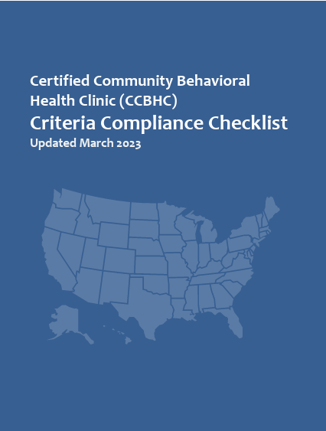

How Zero Suicide Supports CCBHC Certification
Notes:
Zero Suicide is not just a standalone model; it’s a system-wide approach that aligns seamlessly with the principles and practices of CCBHCs. From universal screening and risk assessment to data-driven quality improvement, Zero Suicide enhances each component of the CCBHC model, ensuring safer, more responsive, and more coordinated care for individuals at risk of suicide.
We’ll walk through key areas where Zero Suicide offers tools, protocols, and structures that directly meet or exceed CCBHC requirements—showing how integration leads to better outcomes and stronger compliance.

Slide 10
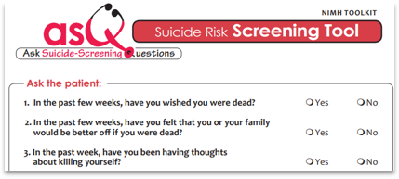
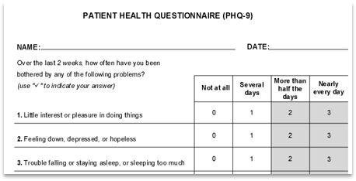
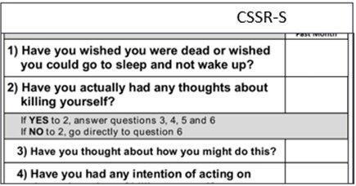
Enhances Risk Identification Requirements
Universal screening at every encounter
Use of evidence-based tools (e.g., ASQ, C-SSRS)
Trains all staff for their role in identification
Notes:
CCBHCs require screening at intake and during care.
Zero Suicide promotes universal screening—not just at intake or based on clinical judgment, but across all service encounters and levels of care.
This aligns with CCBHC expectations for consistency and accountability.
It ensures that suicide risk isn’t missed during routine visits, check-ins, or encounters with non-clinical staff.
Example: A client may express distress to a peer specialist, case manager, or nurse—not just their therapist. Universal screening means everyone is alert to that possibility and knows what to do.
2. Implements Evidence-Based Tools Across Roles
Zero Suicide recommends the use of validated tools like:
ASQ (Ask Suicide-Screening Questions) — brief and designed for various settings.
C-SSRS (Columbia Suicide Severity Rating Scale) — widely adopted and used across populations.
These tools:
Standardize risk identification
Ensure staff know how to screen and interpret responses
Reduce variability and bias in who gets screened and how
3. Trains All Staff for Their Role in Identification
A core principle of Zero Suicide is that everyone has a role in suicide prevention—not just behavioral health professionals.
Front desk staff, crisis line responders, outreach workers, and case managers receive training on how to recognize and respond to suicide risk within their role at the organization
This aligns with the CCBHC expectation of risk screening being integrated throughout care—not siloed to one team.
Toolkit support: “Identify” section, Suicide Screening Tools

Slide 11
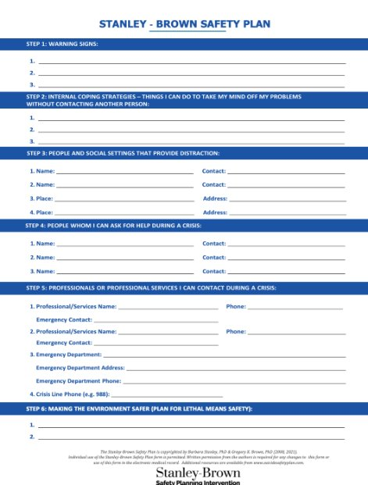
Supports Person-Centered Crisis Planning
Collaborative safety planning
Least restrictive care using the Stepped-Care Model
Integrates crisis planning into larger suicide care pathway.
Notes:
After a psychiatric emergency, CCBHCs must develop individualized crisis plans.
Collaborative Safety planning: Zero Suicide reframes safety planning as collaborative, not prescriptive. This strengthens trust, enhances engagement, and aligns with trauma-informed care principles.
It promotes the use of evidence-based approaches like the Stanley-Brown Safety Plan, a brief, structured intervention done with the individual.
This model emphasizes the individual’s voice, preferences, and lived experience—making the plan more relevant and likely to be used in real-life situations.
2. Promotes Least Restrictive Care via Stepped-Care Models
Zero Suicide emphasizes that people at risk of suicide should be treated in the least restrictive environment that can safely meet their needs. This supports CCBHC principles of recovery-oriented care.
The Stepped-Care Model offers a framework for right-sizing care—only escalating to hospitalization when truly necessary, and favoring outpatient supports, mobile crisis, and peer supports when appropriate.
This reduces the risk of retraumatization, maintains autonomy, and fosters longer-term engagement.
3. Zero Suicide integrates crisis planning into a larger suicide care pathway—so it doesn’t sit in isolation.
The plan becomes part of ongoing treatment and is revisited regularly.
It connects to outreach efforts like caring contacts and follow-up care post-crisis or discharge.
This closes the loop between emergency care and long-term recovery, a key CCBHC goal.
Toolkit support: Collaborative Safety Plan, Stepped-Care Model, Crisis Plan Templates

Slide 12

Strengthens Crisis Services
Emphasizes timely follow-up.
Builds and formalizes Memoranda of Understanding with key partners.
Establishes non-demand caring contacts as a standard of support.
Integrates transition planning into the suicide care pathway.
Notes:
The period after discharge from crisis care is high-risk for suicide. Zero Suicide recommends timely outreach—calls, texts, or appointments—and ensures coordination with EDs and law enforcement. Formal Memorandums Of Understanding (MOUs) and standardized workflows prevent gaps in service and improve safety during transitions.
1. Emphasizes Timely Follow-Up—Not Just Access
Zero Suicide prioritizes proactive outreach—not waiting for the individual to reach out, but initiating contact quickly and consistently.
Best practices supported by Zero Suicide call for follow-up within 24–48 hours after discharge from EDs, inpatient units, or mobile crisis contact.
These follow-ups can include:
Phone calls
Text messages
Home visits
Virtual or in-person sessions
Peer support check-ins
2. Builds and Formalizes MOUs with Emergency and Inpatient Providers. Zero Suicide encourages formal Memoranda of Understanding (MOUs) and protocols between the CCBHC and:
Emergency departments (EDs)
Inpatient psychiatric units
Law enforcement or mobile crisis teams
These agreements:
Define roles and responsibilities
Clarify handoff procedures
Ensure warm transitions, not cold discharges
This prevents individuals from falling through the cracks and aligns with CCBHC requirements for documented coordination agreements.
3. Establishes “Non-Demand Caring Contacts” as a Standard of Support
Zero Suicide includes the practice of “non-demand caring contacts”—brief messages that express support and connection (e.g., “We’re thinking of you,” “Your care team is here for you”. They are non-demand because they have no expectation that the client will respond.
These are non-clinical, low-cost, and highly effective in reducing suicide attempts and re-engagement in services.
They can be delivered by peers, clinicians, or other team members.
These contacts support engagement and retention, reduce no-shows, and offer a bridge between crisis and continuing care.
4. Integrates Transition Planning into the Suicide Care Pathway
In Zero Suicide, transitions are not an endpoint, but part of a continuum of care that includes:
Collaborative safety planning before discharge
Clear follow-up appointment scheduling
Consent-sharing for inter-agency communication
Documentation of who is responsible for outreach and care linkage
This supports the CCBHC’s need to track and coordinate care until the individual is actively engaged in services or assessed to be no longer at risk.
Toolkit support: “Transition” section, Follow Up Matters, Safe Care Transitions Toolkit

Slide 13
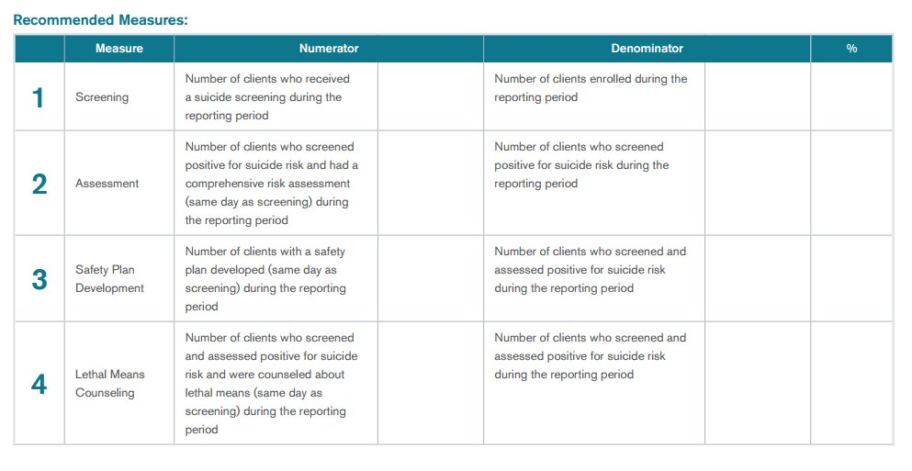
Drives Quality Improvement in Suicide Care
Key CCBHC Reporting Measures Supported by Zero Suicide
Organizational self-study and Just Culture reviews
Reinforces accountability and system-level improvements.
Notes:
CCBHCs are required to report on a range of quality measures found in Appendix B of the Certification Criteria—several of which directly align with Zero Suicide practices. Here’s how Zero Suicide helps meet and exceed those reporting expectations:
NQF #0104 (Follow-Up After Hospitalization for Mental Illness, 7-Day):
Zero Suicide emphasizes timely follow-up post-crisis and uses workflows to ensure contact is made within 24–48 hours—well within the 7-day benchmark.
NQF #1879 (Suicide Risk Assessment):
A core component of Zero Suicide is the universal screening and assessment of suicide risk using validated tools like C-SSRS or ASQ at every care touchpoint.
NQF #1365 (Child and Adolescent Major Depressive Disorder: Suicide Risk Assessment):
Zero Suicide supports developmentally appropriate tools and protocols for youth populations, aligning with this child-specific requirement.
Screening for clinical depression and follow-up plan (CMS eCQM #2):
Zero Suicide encourages screening and builds in response workflows, ensuring any positive screen for depression or suicide risk leads to a follow-up plan.
Quality Processes:
Suicide deaths and attempts are reviewed through Just Culture-informed review processes. These reviews focus on identifying system-level breakdowns rather than individual fault.
The Organizational for implementing the Zero Suicide framework—highlighting strengths and identifying gaps in suicide care infrastructure, policy, and practice.
Self-Study assesses system readiness
Overall, Zero Suicide strengthens your CQI infrastructure, ensuring that required measures are not just collected for reporting but also leveraged for meaningful and sustained improvement in suicide care.

Slide 14
PROCEDURES
Values of people who have lived experience with suicide care
LIVED EXPERIENCE
WORK
FLOWS
POLICIES
Notes:
A cornerstone of Zero Suicide is the inclusion of people who have lived experience of suicide attempts or have lost someone to suicide. We want to include the perspective and input of people with lived experience when we develop policies, procedures, and workflows. Their perspective and recommendations will help us develop truly person-centered approaches for patients at risk of suicide.

Slide 15

Supports Inclusive CCBHC Governance
Ensures lived experience members are not isolated or tokenized.
Create equitable structures in which people with lived experience are engaged in leadership.
Lived experience knowledge and clinical expertise is equally valued.
Notes:
CCBHCs require participation from individuals with lived experience on governance bodies. But simply having a seat at the table is not enough. Zero Suicide pushes us to reframe that role—not just as representation, but as leadership.
From Tokenism to Integration:
Are we listening to people with lived experience, or involving them only when it’s convenient?
Invite lived experience representatives to co-create agendas, lead subcommittees, and participate in all strategic decisions—not just those labeled “consumer-related.”
Avoid isolating lived experience members; ensure they are part of conversations on operations, policy, finance, and quality improvement.
2. Creating Equitable Structures:
Provide orientation, leadership development, and mentorship for lived experience members—just as we do for clinicians and executives.
Compensate peer leaders fairly for their time and expertise.
Rotate leadership roles or co-chair positions to ensure lived experience input influences decisions, not just reviews them.
3. Cultural Shifts:
People with lived experience should not need to validate their presence—they should be valued for it.
Foster a governance culture that values narrative and relational knowledge alongside clinical or administrative expertise.
Recognize lived experience as a core component of safe care, as outlined in the Zero Suicide framework.
Lived Expereince in Zero Suicide Implementation:
Include lived experience advisors in planning care pathways, postvention policies, and staff training.
Bring their voice into the CQI loop—what metrics matter from a lived experience lens? How does the system feel to someone navigating it during crisis?
In Zero Suicide, lived experience isn't an add-on. It's a guiding principle for how we design systems that are safe, responsive, and grounded in the realities of those we serve.
Tools: Lived Experience Leadership Webinar, Peer Services Tools

Slide 16
[REMOVE PRIOR TO PRESENTATION]
Show the video Voices of Zero Suicide. You may wish to access the Zero Suicide Toolkit and load the video in a separate window, or to embed the videos into your presentation using the links below.
NOTE: Be sure to test embedded videos beforehand; the Vimeo software will show an error unless the video is embedded
If you wish to load the videos in a separate window, access them via our toolkit:
Voices of Zero Suicide: https://zerosuicide.edc.org/resources/resource-database/voices-zero-suicide
If you wish to embed the videos, use the following Vimeo links:
Voices of Zero Suicide: https://vimeo.com/1014442192

Slide 17



Zero Suicide is a Team Effort
  Everyone has a role to play in suicide prevention​
  Everyone will get some training specific to your role
Notes:
Everyone in the organization plays a role in making Zero Suicide successful in our organization. Everyone is an important part in suicide prevention no matter what their role is. Training is part of any new initiative and so everyone will get some training on suicide specific to their role. People who work with patients directly will get certain trainings and people who work in non-clinical roles will also have some training related to suicide.

Slide 18
Aim for ZERO and Prepare to Support Staff When a
Patient Dies by Suicide
1
2
3
POSTVENTION SUPPORT
JUST
CULTURE
EMPLOYEE
WELLNESS
Notes:
A Zero Suicide organization aims for no patient suicide deaths and also prepares for when a patient dies by suicide. Aiming for zero helps us have a certain mindset. If we’re aiming for a certain reduction of suicide deaths that could be interpreted that there is another acceptable number of suicide deaths. Zero is really the only acceptable number. And because we also know that there are many things that contribute to a person’s decision to take their own life we will make sure we have good postvention support for staff after a patient dies by suicide. A big part of Zero Suicide is having a Just Culture which means that when there is an incident or an error we focus on identifying system gaps instead of blaming staff. Also, Zero Suicide includes supporting the wellness of our employees who are doing the hard work of helping people who are at risk of suicide.

Slide 19

Zero Suicide is a Journey
That Never Ends
CORE COMPONENTS
OF SAFE SUICIDE CARE
Continuous Quality Improvement
  Collecting, reviewing, and using data to improve​ care
  Assuring fidelity to the Zero Suicide framework
Notes:
Zero Suicide isn’t just a training or a screening process. It’s intended to be a journey without a destination. We want to have the mindset and the processes to support the collection, review and use of data to improve the way we care for patients and support employees. We also want to make sure we have fidelity to the Zero Suicide framework and to the interventions and procedures we implement. Zero Suicide is a continuous quality improvement project. It’s not something to implement and move on.

Slide 20

What Does Zero Suicide Look Like?
Seeking new and better ways to help our patients
Using culturally appropriate, evidence-based tools and practices
Training to improve comfort, confidence, and competence to work with suicidal patients ​
Notes:
Zero Suicide is a framework that is intended to be adaptable to our organization and the populations we serve. It centers cultural appropriate and evidence-based tools and practices. And includes training that doesn’t just focus on knowledge and skills but increases the comfort and confidence as well as the competence of our staff to work with our most at risk patients.

Slide 21
[REMOVE PRIOR TO PRESENTATION]
Show the following video. You may wish to access the toolkit and load the videos in a separate window, or to embed the videos into your presentation using the links below.
NOTE: Be sure to test embedded videos beforehand; the Vimeo software will show an error unless the video is embedded.
If you wish to load the video in a separate window, access it via our Toolkit:
7 Elements of Zero Suicide: https://zerosuicide.edc.org/resources/resource-database/seven-elements-zero-suicide
If you wish to embed the videos, use the following Vimeo link:
7 Elements of Zero Suicide: https://vimeo.com/881844818
Notes:
Zero Suicide is a framework that is organized into seven different elements. Here is a video that briefly goes over these elements.
https://zerosuicide.edc.org/resources/resource-database/seven-elements-zero-suicide
https://vimeo.com/881844818

Slide 22
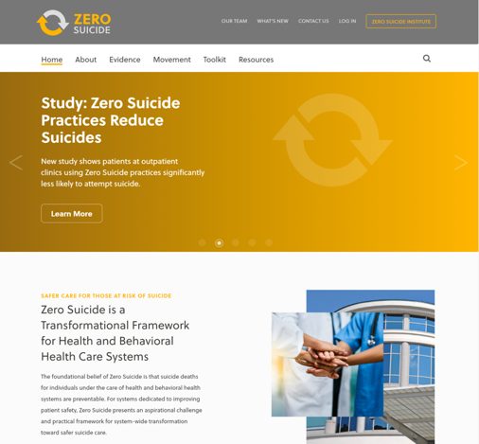

Zero Suicide Toolkit
The online Zero Suicide Toolkit offers free and publicly available tools, strategies, and resources.
CORE COMPONENTS
OF SAFE SUICIDE CARE
RESOURCES
Information
Materials
Outcomes
Innovations
Research
Tools
Readings
Videos
Webinars
Podcasts
CORE COMPONENTS
OF SAFE SUICIDE CARE
ZeroSuicide.edc.org
Notes:
The Zero Suicide website is something that all of us can use for different resources that might be helpful as we start implementing different parts of Zero Suicide. The Toolkit has a lot of great information and resources. The website address is: www.ZeroSuicide.edc.org.

Slide 23
Thank You
Visit zerosuicide.edc.org to learn more about Zero Suicide
Contact zerosuicide@edc.org
for questions or assistance
Notes:
We are really excited to start this work and looking forward to everyone’s contributions. Providing the best care for our patients is who we are, not only what we do. The work we do in Zero Suicide will provide us a holistic and comprehensive path to follow that will improve our organizational culture as it related to suicide care for our patients.

